Slide 1
IoMT Wearable Security
Senior Design
Presented by:
Jacson Ott, Trevor Hornsby, Matthew Chau, and Stu Kernstock

Slide 2
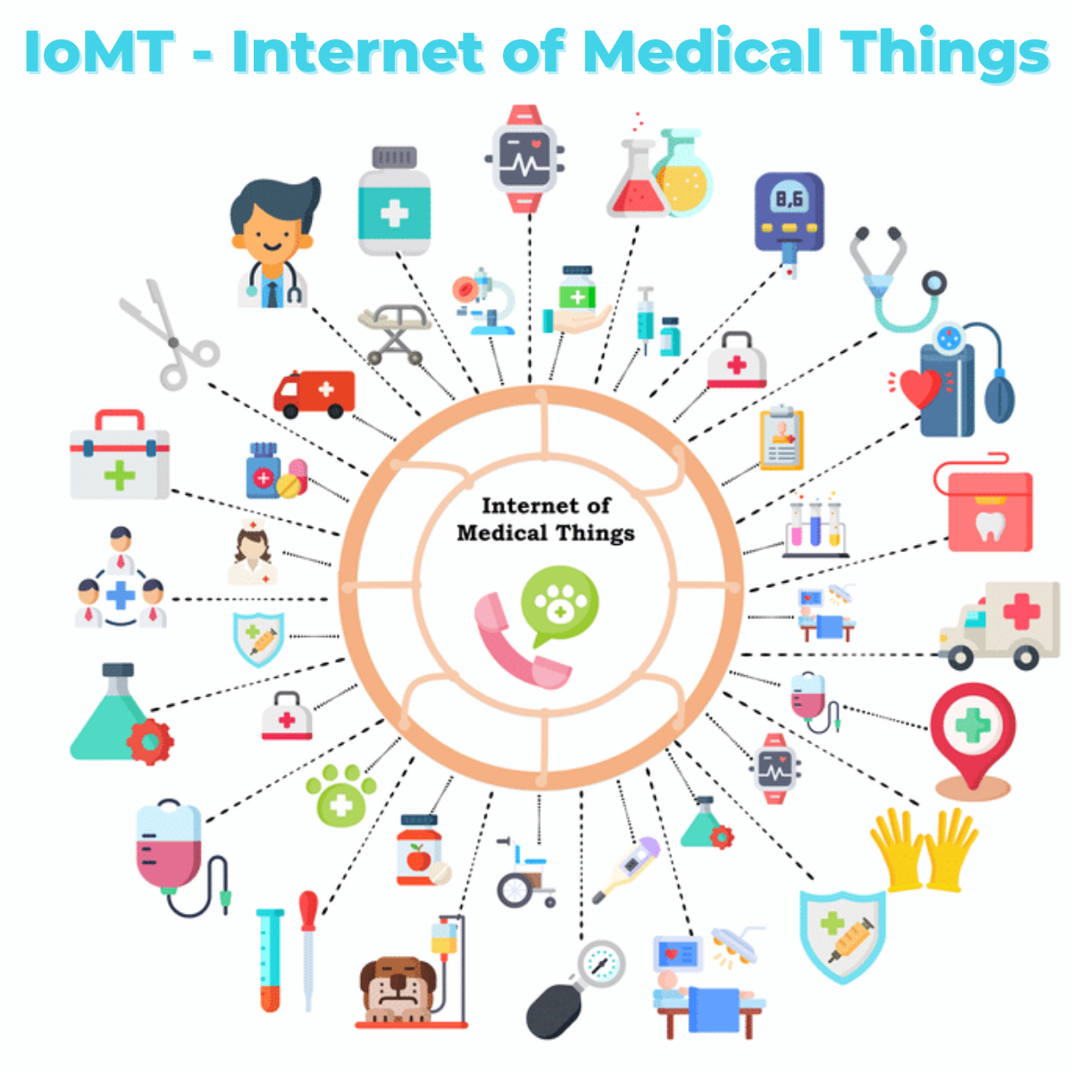
Introduction
Internet of Things (IoT)
Objects with embedded computers which collect and share information
Internet of Medical Things (IoMT)
IoT enabled devices that collect and handle personal health information
https://waterstream.io/2021/02/15/the-impact-of-the-iomt-on-the-healthcare-industry/
Notes:
Give example IoT and IoMT devices: google homes, smart bulbs -> heart rate monitors, patient monitors, MRI machines

Slide 3
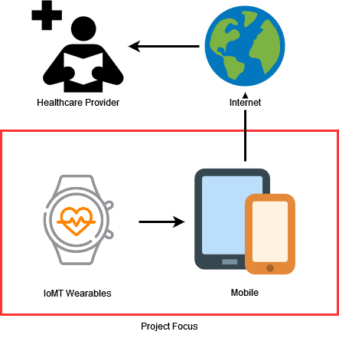
Problem Statement
IoT devices are notoriously insecure
[1] Over 50% of IoT devices were vulnerable to medium or high severity attacks in 2020, according to Unit 42
Medical data is a high-value target for attackers
[2] AT&T Cybersecurity reported that medical data accounted for more than 43% of data breaches in 2021
Scope of Research
Phones, Wearables, and Applications
Notes:
over half of all IoT devices were vulnerable to attacks in 2020 and medical data made up more than 43% of all data compromised in breaches in 2021
these are big issues we face as users of IoMT devices
for our research, we narrowed our scope to focus only on the security of the wearables, the phones, and the applications that the wearables communicated with on the phones

Slide 4
Methodology
Test multiple attack vectors for effectiveness against modern security controls
Results will be used to make relevant security recommendations for these devices
Success
Any Attack that compromises Confidentiality, Integrity, and/or Availability
Notes:
In our project we performed our tests across a broad spectrum of attack vectors and categories,
and we used the results from both successful and unsuccessful attacks to make our remediations
successful attacks within the context of our research are defined as any attack that was able to successfully compromise any element of the CIA triad
and for our research methodology, we used a phased approach which can be seen in the flow diagram at the bottom of the slide

Slide 5
Summary of Attacks
Key:
Success: ✅
Limited Success: 🔒
Failure: ⛔
Attack/Device | Amazon Halo | Apple Watch 3 | Fitbit Charge 4 | Popglory | Wyze Watch
DoS | ⛔ | ⛔ | 🔒 | ✅ | 🔒
Fuzzing | ⛔ | ⛔ | ⛔ | ⛔ | ⛔
Hijacking | ⛔ | ⛔ | ⛔ | ✅ | 🔒
Physical | ⛔ | ⛔ | ⛔ | ⛔ | ⛔
Reverse Engineering | ? | ? | 🔒 | 🔒 | ?
Sniffing | ⛔ | ⛔ | 🔒 | ✅ | ✅
Spoofing | 🔒 | ⛔ | 🔒 | ✅ | ⛔
Notes:
Success = full compromise of Confidentiality, Integrity, or Availability
We tested a variety of attacks on every device with varying degrees of success. For example, sniffing attacks were not successful against the apple watch our hardware was unable to follow the connection. Sniffing had limited success against the Fibit Charge 4 since we were able to see the traffic between the device and smartphone but it was encrypted. Sniffing was successful against the Popglory and Wyze and we were able to see the user’s heart rate values (elaborate on why these heart rate values are important)

Slide 6
Remediations
Manufacturers and Developers:
Implement encryption for connections
Use Bluetooth 5.0 or higher
Implement random MAC addresses
Users:
Avoid unnecessary pairing and unpairing
Opt for reputable brands

Slide 7
Thank you
Our Paper: https://www.overleaf.com/read/xgkgjqdnkzcd

